Slide 1
STOCK PRICE
PREDICTION
BY
ABHISHEK MAHATO

Slide 2
6.) How can we attempt to predict future stock behavior? (Predicting the closing price stock price of APPLE inc using LSTM)
)
PROBLEM STATEMENT
In this notebook we will be looking at data from the stock market. We will learn how to use pandas to get stock information, visualize different aspects of it, and finally we will look at a few ways of analyzing the risk of a stock, based on its previous performance history. We will also be predicting future stock prices through a Long Short Term Memory (LSTM) method!
We'll be answering the following questions along the way:
1.) What was the change in price of the stock over time?
2.) How can we attempt to predict future stock behavior? (Predicting the closing price stock price of AAPL inc using LSTM)

Slide 3
OBJECTIVES:
Minimise the difference between the predicted
and true value of stocks

Slide 4
DATA OVERVIEW
Source : https://www.kaggle.com/nlp-lstm-stock-price-prediction/data?select=Stock_Price_Prediction_AAPL_data.csv
There are total 1259 diffrent unique values of stocks which tells us about following things
HIGH
LOW
OPEN
CLOSE
VOLUME

Slide 5
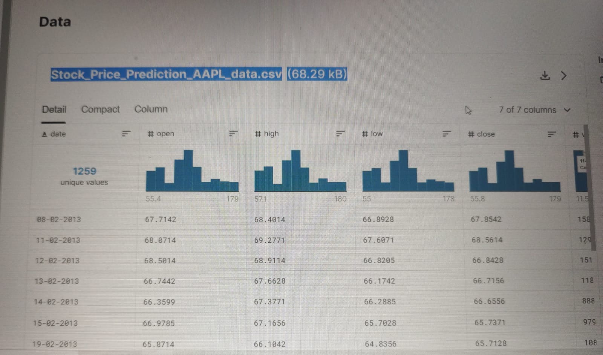
EXAMPLE OF STOCKS DATA

Slide 6
* LOSS FUNCTION FOR CLASSIFICATION
(Mean Squared Error)
Optimizer
Adam (Adaptive Moment Estimation)

Slide 7
Sequential Model
A Sequential model is appropriate for a plain stack of layers where each layer has exactly one input tensor and one output tensor.
Any of your layers has multiple inputs or multiple outputs. You need to do layer sharing.
each layer has exactly one input tensor and one output tensor.
A Sequential model is not appropriate when:
Your model has multiple inputs or multiple outputs
Any of your layers has multiple inputs or multiple outputs
You need to do layer sharing
You want non-linear topology (e.g. a residual connection, a multi-branch model)

Slide 8
Long Short-Term Memory (LSTM)
1) Long Short-Term Memory (LSTM) networks are a type of recurrent neural network capable of learning order dependence in sequence prediction problems.
2) This is a behavior required in complex problem domains like machine translation, speech recognition, and more.
LSTMs are a complex area of deep learning.
3) It can be hard to get your hands around what LSTMs are, and how terms like bidirectional and sequence-to-sequence relate to the field.

Slide 9
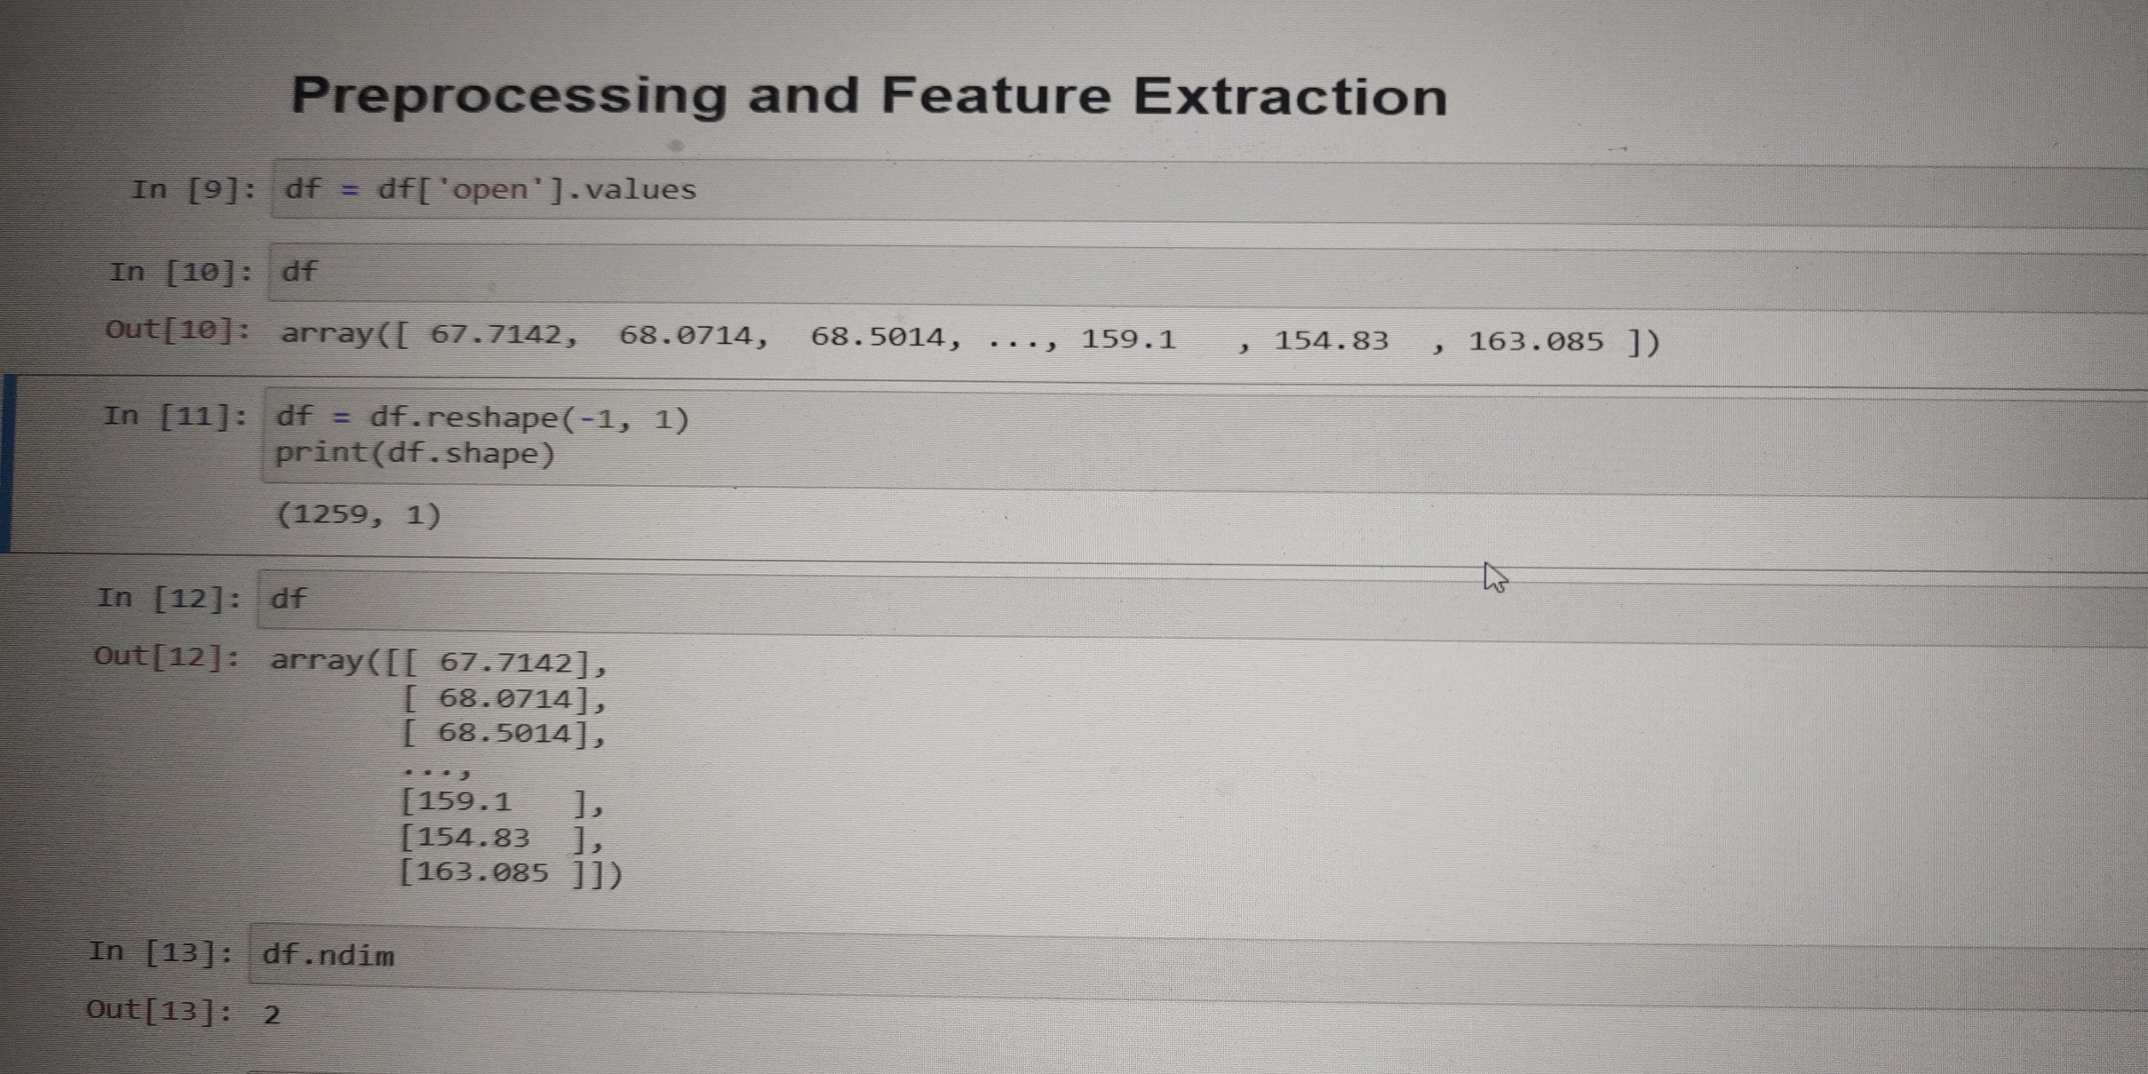
Preprocessing and Feature Extraction

Slide 10
sklearn.preprocessing.MinMaxScaler
* Transform features by scaling each feature to a given range.
This estimator scales and translates each feature individually such that it is in the given range on the training set, e.g. between zero and one.
where min, max = feature_range.
** data_range_ndarray of shape (n_features,)
Per feature range (data_max_ - data_min_) seen in the data

Slide 11
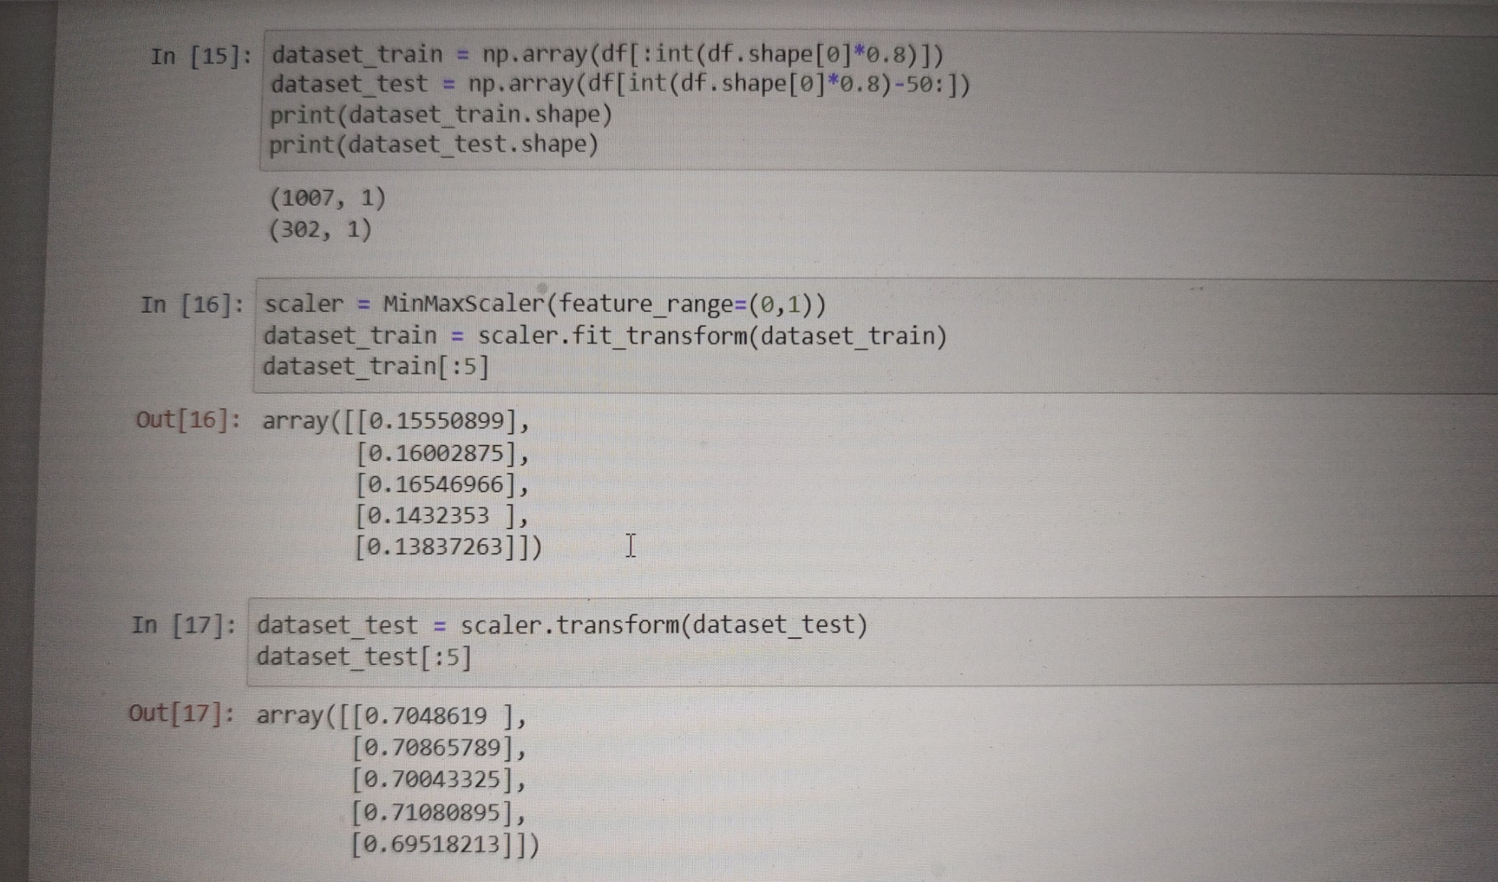

Slide 12
(252, 50)
STRUCTURE
We have 2 folders; one is train and other is test, both x_train contains (957,50) values while x_test (252,50) of stocks.

Slide 13
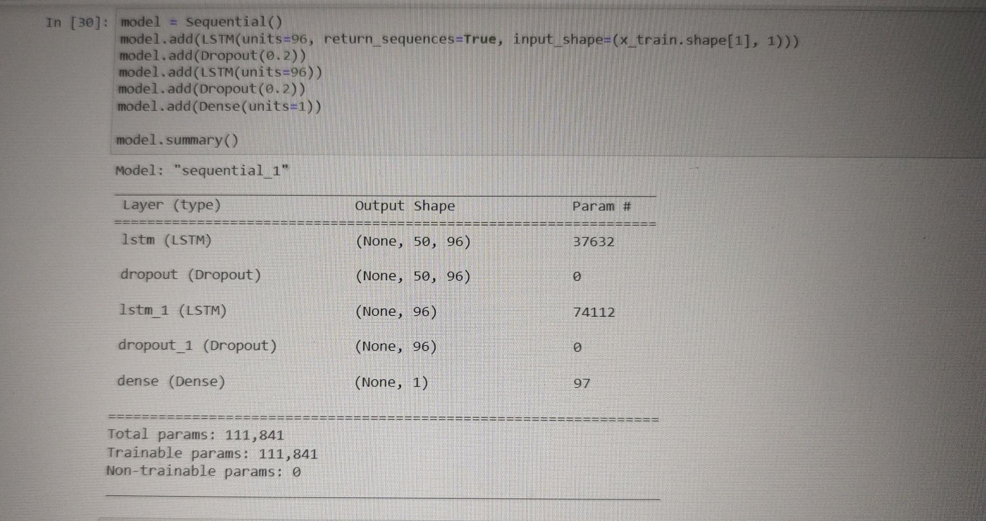
Building Model

Slide 14
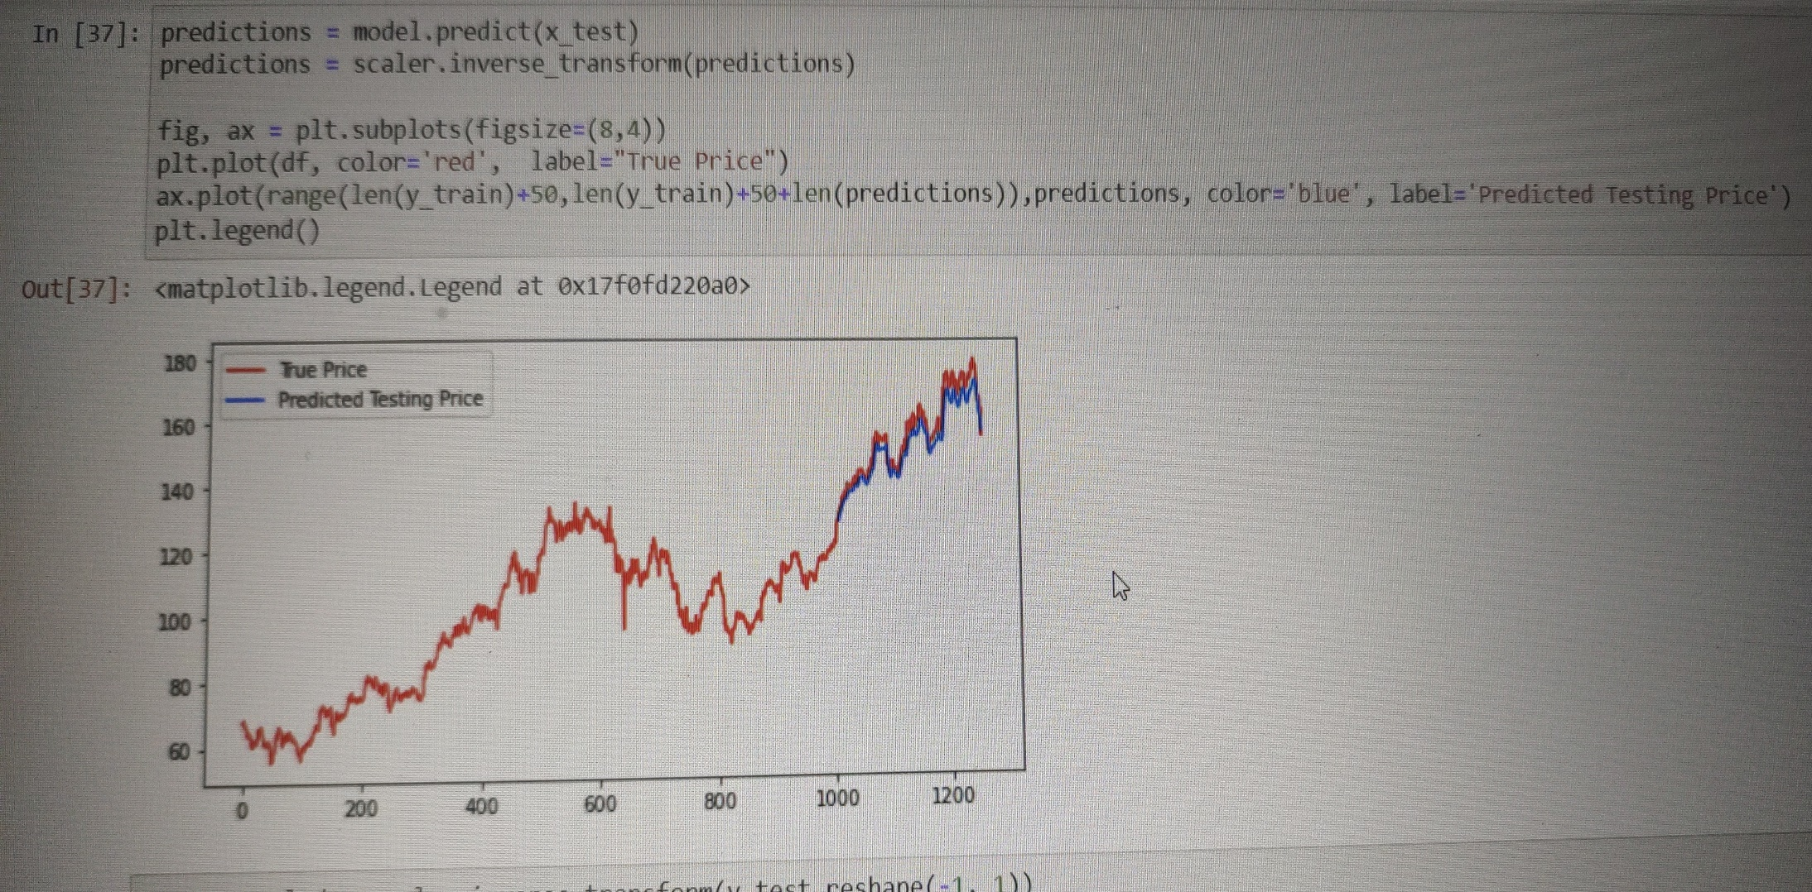
Visualizing Results
X_test

Slide 15
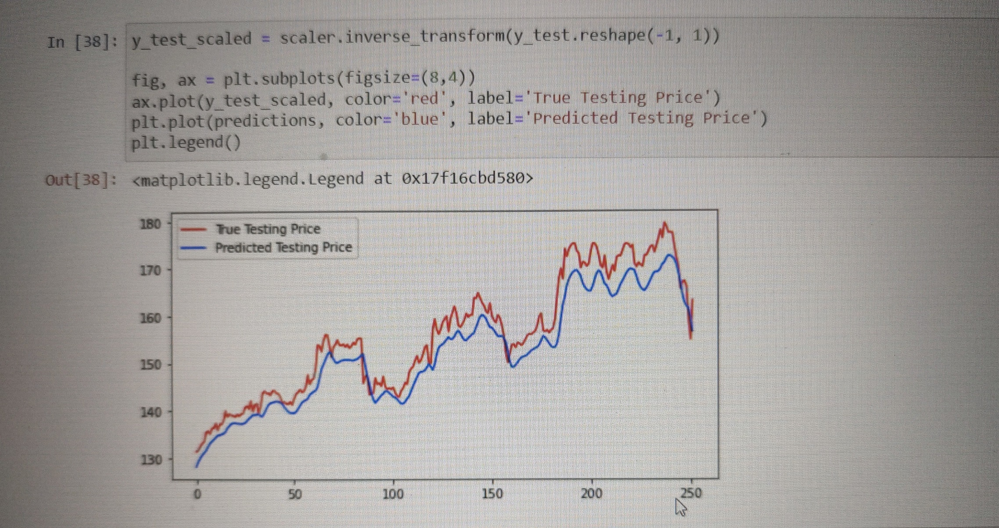
y_test

Slide 16
THANK YOU!!!!!!

